Slide 1
Time Delay Neural Network
1. TDNN
2. 모델 구조

Slide 2
1. A time delay neural network architecture for efficient modeling of long temporal contexts (2015)
2. Deep Neural Network Embeddings for Text-Independent Speaker Verification (2017)
3. X-VECTORS: ROBUST DNN EMBEDDINGS FOR SPEAKER RECOGNITION (2018)
4. Attentive Statistics Pooling for Deep Speaker Embedding (2018)

Slide 3
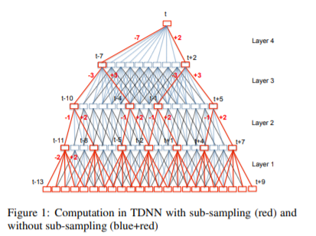
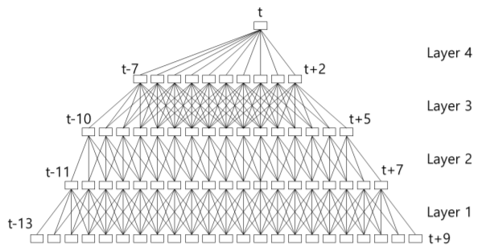
1. A time delay neural network architecture for efficient modeling of long temporal contexts (2015)
TDNN

Slide 4
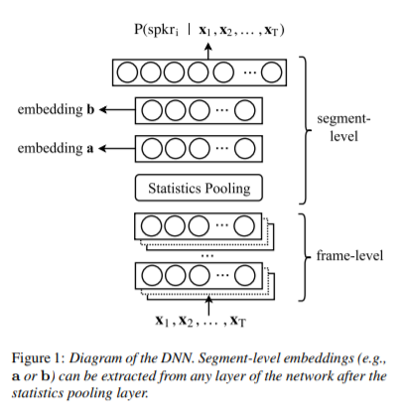
2. Deep Neural Network Embeddings for Text-Independent Speaker Verification (2017)

Slide 5
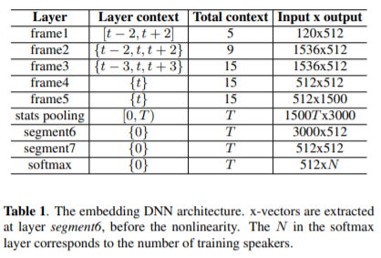
3. X-VECTORS: ROBUST DNN EMBEDDINGS FOR SPEAKER RECOGNITION (2018)

Slide 6
4. Attentive Statistics Pooling for Deep Speaker Embedding (2018)

Slide 7
github: https://github.com/cvqluu/TDNN

